Slide 1
VUE.js
Garret Mullings
Rory Schillo

Slide 2

What is VUE.js?
Javascript Framework for frontend development
Features:
Declarative Rendering: imbed HTML in javascript
Reactivity: update DOM when javascript state changes
Mimics OOP programming!

Slide 3
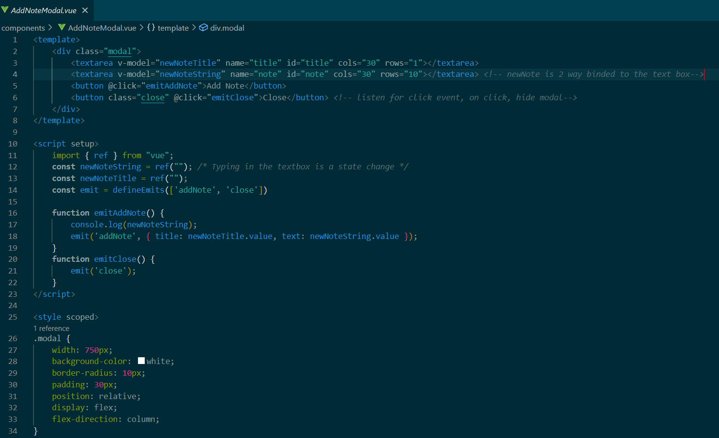
Components
Put your HTML, Javascript, and CSS styling all in a single, encapsulated file

Slide 4
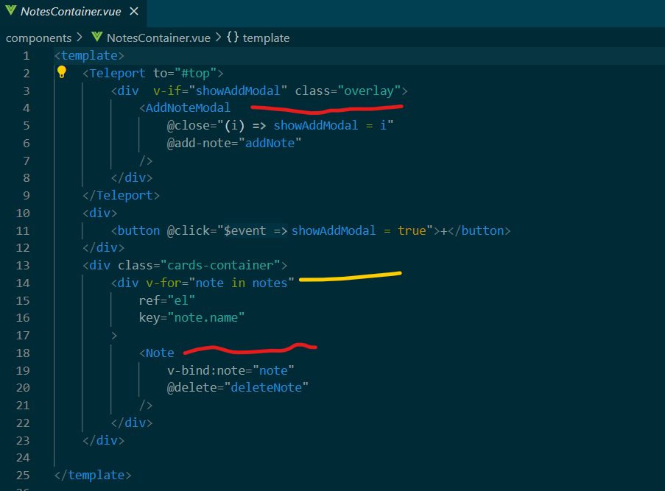
Components
Once created, components can be used and reused anywhere. Much like a Java class!
Red lines are components created in separate files.
Yellow line is a for-loop

Slide 5
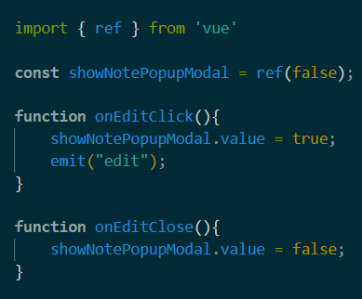
Reactivity:
Vue uses reactivity, wrap your variables with vue’s ref() function.
Then, when the variable’s .value field is updated the DOM is updated automatically

Slide 6
Vue.JS Conclusion
Declarative Rendering
Reactivity
Components allow HTML, Javascript, and CSS to be encapsulated in a single file.
Components can be reused anywhere
When variables change in the Javascript the DOM is updated automatically
Variables must be wrapped with ref()

Slide 7
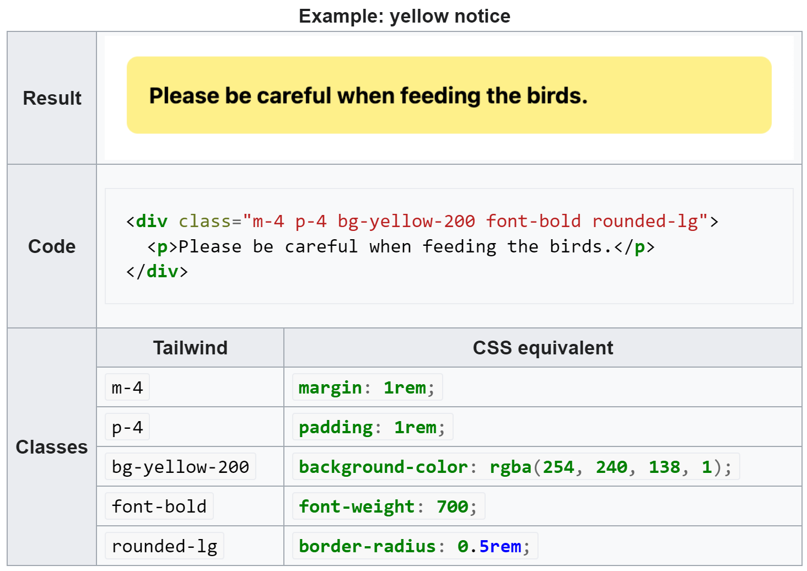
TAILWIND
Is a CSS framework that relies on “utility” classes to quickly change the styling of your components.
Utility classes are built around individual stylings which is different than other frameworks and traditional CSS.

Slide 8
PROJECT Demo
VUE NOTES

